Slide 1
Introduction to UML
Visualising code
Programming – Code Design & Data Structures

Slide 2
Contents
The Case for Modelling
What is UML?
Why You Should Use UML
When You Should Not Use UML
UML FAQ

Slide 3

The Case for Modelling
Imagine an architect building a house without a blueprint
Measurements will be wrong
A poor foundation can mean an unstable structure
Each worker will have a different vision of the final product
A lot of work will have to be redone

Slide 4
The Case for Modelling
Software Engineers (that’s you!) also have a way of documenting the design of their programs
This is called UML
Unified Modelling Language
UML defines a series of different diagrams that can help you visualize and design your programs or systems

Slide 5
Why Use UML?
Building complex software without a design is similar to building a house without a blueprint
Unforeseen problems can lead to a lot of code refactoring
Refactoring takes time
Less time means fewer features and less polish
Refactoring increases the chance of bugs
New team members won’t know how things should work

Slide 6
What is UML?
UML is a modelling language software
It’s a software industry standard
It provides a standard way of visualizing a system or program
Like pseudo code, it’s independent of any language
UML defines 13 types of diagrams, divided into three categories
Structure, Behaviour, and Interaction
Like all languages, it defines syntax (graphical symbols and text) and semantics (the underlying meanings of the symbols and text)
This means tools can automatically create code from a UML design

Slide 7
Why You Should Use UML
Allows you to focus on ideas and designs, rather than implementation details
UML can work at multiple levels of abstraction
Create and communicate designs before committing additional resources
Offers an effective way to understand what you’re building
Trace the design back to the requirements
Verify you’re actually building the right thing
Work at higher levels of abstraction, allowing quick and frequent changes
Iterating on a high-level design will save time when implementing your designs in code

Slide 8
When You Should Not Use UML
The problem domain is well known
The solution is relatively easy to construct
Very few people need to collaborate to build or use it
Minimal ongoing maintenance is required
The scope of future needs is unlikely to grow substantially
Does this sound like the average AAA game?
A: NO! Commercial games are very complex, can have large teams, take years to develop, involve ongoing support, and have changing requirements

Slide 9
Resistance is… cultural
UML is currently the best tool programmers and software engineers have to describe programs
Objections to using UML are largely cultural
Some programmers may never work on systems with enough complexity to warrant designing in UML
Many game programmers build the same systems over and over
When projects do become complex, many are comfortable using the IDE and debugger and simply working more hours
Some may not have bothered to learn it, or learnt it poorly
UML gets much easier and more valuable with practice!

Slide 10
UML FAQ
Q: Why don’t we just build the real thing?
For complex projects, designing ‘on the fly’ is risky
The original programmers may not even be present at the end of the project
An architect may not need blueprints to build a doghouse, but they’d never construct a 15 story office building without architectural plans, diagrams and a mock-up for visualization

Slide 11
UML FAQ
UML is just Class Diagrams, right?
UML (2.0) defines 13 different diagrams (which include class diagrams)
Not all of UML will be useful to everyone all the time
We’ll only be looking at Class, Sequence, State, Collaboration, and Activity Diagrams
For game programming these will be the most useful

Slide 12
UML FAQ
My friend/reddit/the internet told me UML isn’t used in game studios
Many game studios do use UML
Larger studios with large or distributed teams working on complex projects spanning multiple years will be more likely to need (and use) it than your friend’s indie studio
Text books on software or game engine design will typically use UML diagrams to describe systems
Being able to read, understand, and even write UML can help you communicate your designs or understand the design of someone else

Slide 13
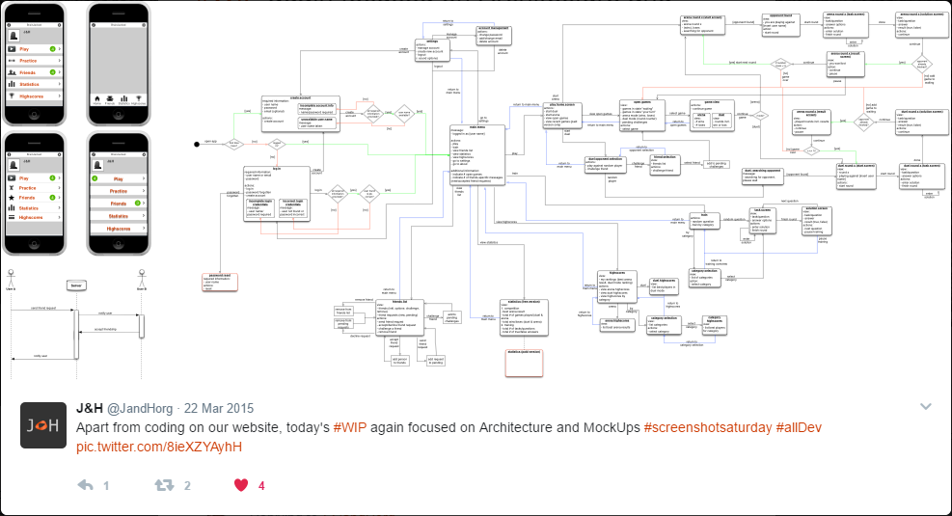

Slide 14
Summary
Unified Modelling Language (UML) is a tool that helps us design our programs, and document those designs
UML is invaluable for large, complex projects, but projects of any size can benefit from better design
Documenting designs can help teams communicate and save time during implementation
UML covers 13 diagrams, although we will only learn a subset of these

Slide 15
References
Gary Cernosek and Eric Naiburg. 2004. The Value of Modeling. IBM. [ONLINE] Available at: http://download.boulder.ibm.com/ibmdl/pub/software/dw/library/rational/pdf/valueofmodeling.pdf. [Accessed 7 April 2017].
Object Management Group Inc. 2017. What is UML | Unified Modeling Language. [ONLINE] Available at: http://www.uml.org/what-is-uml.htm. [Accessed 07 April 2017].

